Slide 1
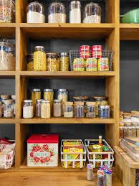
CLOUD BASED SMART PANTRY SYSTEM USING IOT

Slide 2
RELEVANCE OF THE TOPIC
Most of the times, when we want to buy an item from grocery we often can't remember which cooking ingredient (onion, garlic, chili etc.) is running low and some cases we buy wrong item such as garlic instead of.To get rid of such situations we can use this Smart Pantry system and can monitor the amount of every ingredients of the pantry. The data is stored in a cloud platform. These data can be viewed from anyplace

Slide 3
DESCRIPTION OF THE PROJECT
This system provides IoT-based Smart Pantry level monitoring. The containers are fitted with FSR sensors. These are used to gather data about the stock level of items in the container. This data is collected and stored in the cloud. The data is continuously updated. The information includes the changes of weight in regular intervals of time. This system enables a user to view the level of items in a container from any place. The system alerts the user if the container's level goes below minimum weight. We are also using a PIR sensors to detect unusual presence of humans/animals.

Slide 4
OBJECTIVE OF THE STUDY
To study the working of Arduino with different sensors.
To understand operation of GSM module with Arduino uno.
To study function of different sensors like FSR sensor,PIR sensor.
To identify which container is running out of stock.
To send an alert message to the user to restock the item.

Slide 5
EXISTING SYSTEM
In the existing system a person often has to remember the quantity of fruit or vegetable in their home while shopping at the grocery store and sometimes they would end up buying the wrong quantity or the wrong vegetable, in some cases even if the person notes it down before leaving the home another person from the household may consume it and a particular fruit or vegetable may get exhausted or below a required limit of usage.

Slide 6
PROPOSED SYSTEM
In the proposed system the user can view the quantity of particular vegetable or fruit at that particular time from any place through a smartphone or a computer. This system provides updation of the weight of the vegetable or fruit as it gets refilled or exhausted and the weight value changes accordingly for the user to view it from the grocery shop or anywhere else.
This system consists of a Force Sensitive Resistor(sensor),passive infrared sensor, Arduino, Wi-Fi module ,GSM module and cloud. The Force Sensitive resistor is fitted to each container. Then the Force Sensitive Resistors are connected to the Arduino. WIFI module is connected to the Arduino. The sensors collect data and the data is sent to the cloud and stored. This data can be viewed using PC or mobile phone.

Slide 7
Force Sensitive Resistor (FSR) :
These are the sensors used in this system. The FSR has a round sensing area. It changes its value based on the force applied on it. The weight of the stock in the container is calculated by the Arduino with the use of these sensors.
Arduino :
The system uses arduino uno. The sensors are connected with it. It receives the data from the sensors. The arduino uno is also connected to wifi module. The data collected is sent to the cloud through these devices
Wi-Fi module:
It is used to establish connection to a Wi-Fi network.

Slide 8
GSM Module:
The GSM module is used to establish communication between mobile devices. In this system it is used to send alert messages about lower stock levels.
Thing speak
ThingSpeak is an IoT analytics platform service that allows you to aggregate, visualize, and analyze live data streams in the cloud.
ThingSpeak provides instant visualizations of data posted by your devices to ThingSpeak.

Slide 9
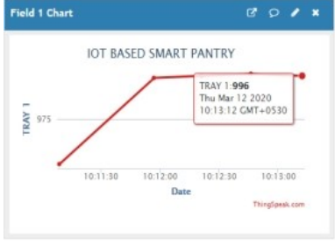
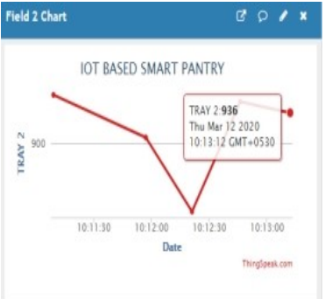

Slide 10
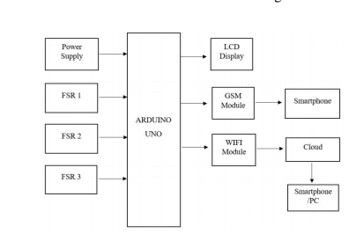

SYSTEM ARCHITECTURE

Slide 11
HARDWARE COMPONENTS
Force Sensitive Resistor (FSR)
PIR sensor
GSM module
Wifi module
SOFTWARE COMPONENTS
Arduino IDE
Thing speak

Slide 12
THANKYOU

